Slide 1


NEXT GEN EMPLOYABILITY PROGRAM
CREATING A FUTURE-READY WORKFORCE
Student Name :
Gunjan Ravindra Bhansali
Student ID :
STU65e1634a89d3a1709291849

Slide 2
CAPSTONE PROJECT SHOWCASE
CARWALA
Car Rental Application with Django Framework
Abstract | Problem Statement | Project Overview | Proposed Solution | Technology Used | Modelling & Results | Conclusion | Q&A

Slide 3
Abstract
1
Django-based car rental applications provide intuitive user interfaces that will allow the customers to view the view the models, descriptions and prices of different cars available.
2
Prioritizes reliability and customer satisfaction, offering well-maintained vehicles, secure payment processing, and responsive customer support.
3
A comprehensive inventory of vehicles is available for users to browse and select based on their preferences and requirements.
4
Secure payment processing ensures seamless transactions, allowing users to pay for their reservations conveniently.

Slide 4


Problem Statement
Existing car rental services often have complicated booking processes, limited inventory, and lack of personalization.
Customers face difficulties finding the right car at the best price, leading to frustration and a suboptimal travel experience.
Our goal is to address these pain points and deliver a user-friendly, efficient, and customizable car rental solution.

Slide 5

Project Overview
The car rental application will provide a comprehensive platform for customers to search, compare, and book rental cars.
Key features will include real-time availability, personalized recommendations, secure payment integration, and a streamlined reservation process.
The application will also offer additional services such as roadside assistance and insurance options to provide a complete transportation solution.

Slide 6
Proposed Solution
Intuitive Interface :
The application will have a clean, user-friendly design that makes it easy for customers to navigate and find the perfect car for their needs.
Personalized Recommendations :
Leveraging data and machine learning, the application will provide personalized recommendations based on the user's preferences, location, and travel details.
Seamless Booking :
Customers can easily compare prices, availability, and car features, then complete the booking process through a secure, integrated payment system

Slide 7
Technology used
1. Django Framework : This is highlighted as the core backend framework due to its robust architecture, which efficiently manages backend functionalities like user authentication, database operations, and URL routing.
2. HTML,CSS & Python : These technologies are mentioned for frontend development. HTML defines the structure of the user interface, CSS styles its appearance, and Python's simplicity and readability make it ideal for building the application's logic.
3. Bootstrap : It is integrated as the frontend framework to accelerate development and ensure responsiveness across various devices. Bootstrap streamlines the development process with its pre-designed components and responsive grid system
4. SQLite : The statement discusses the choice of database management systems. SQLite is preferred for development and testing purposes due to its simplicity, it is used to organize and store data related to users, vehicles, and bookings.

Slide 8
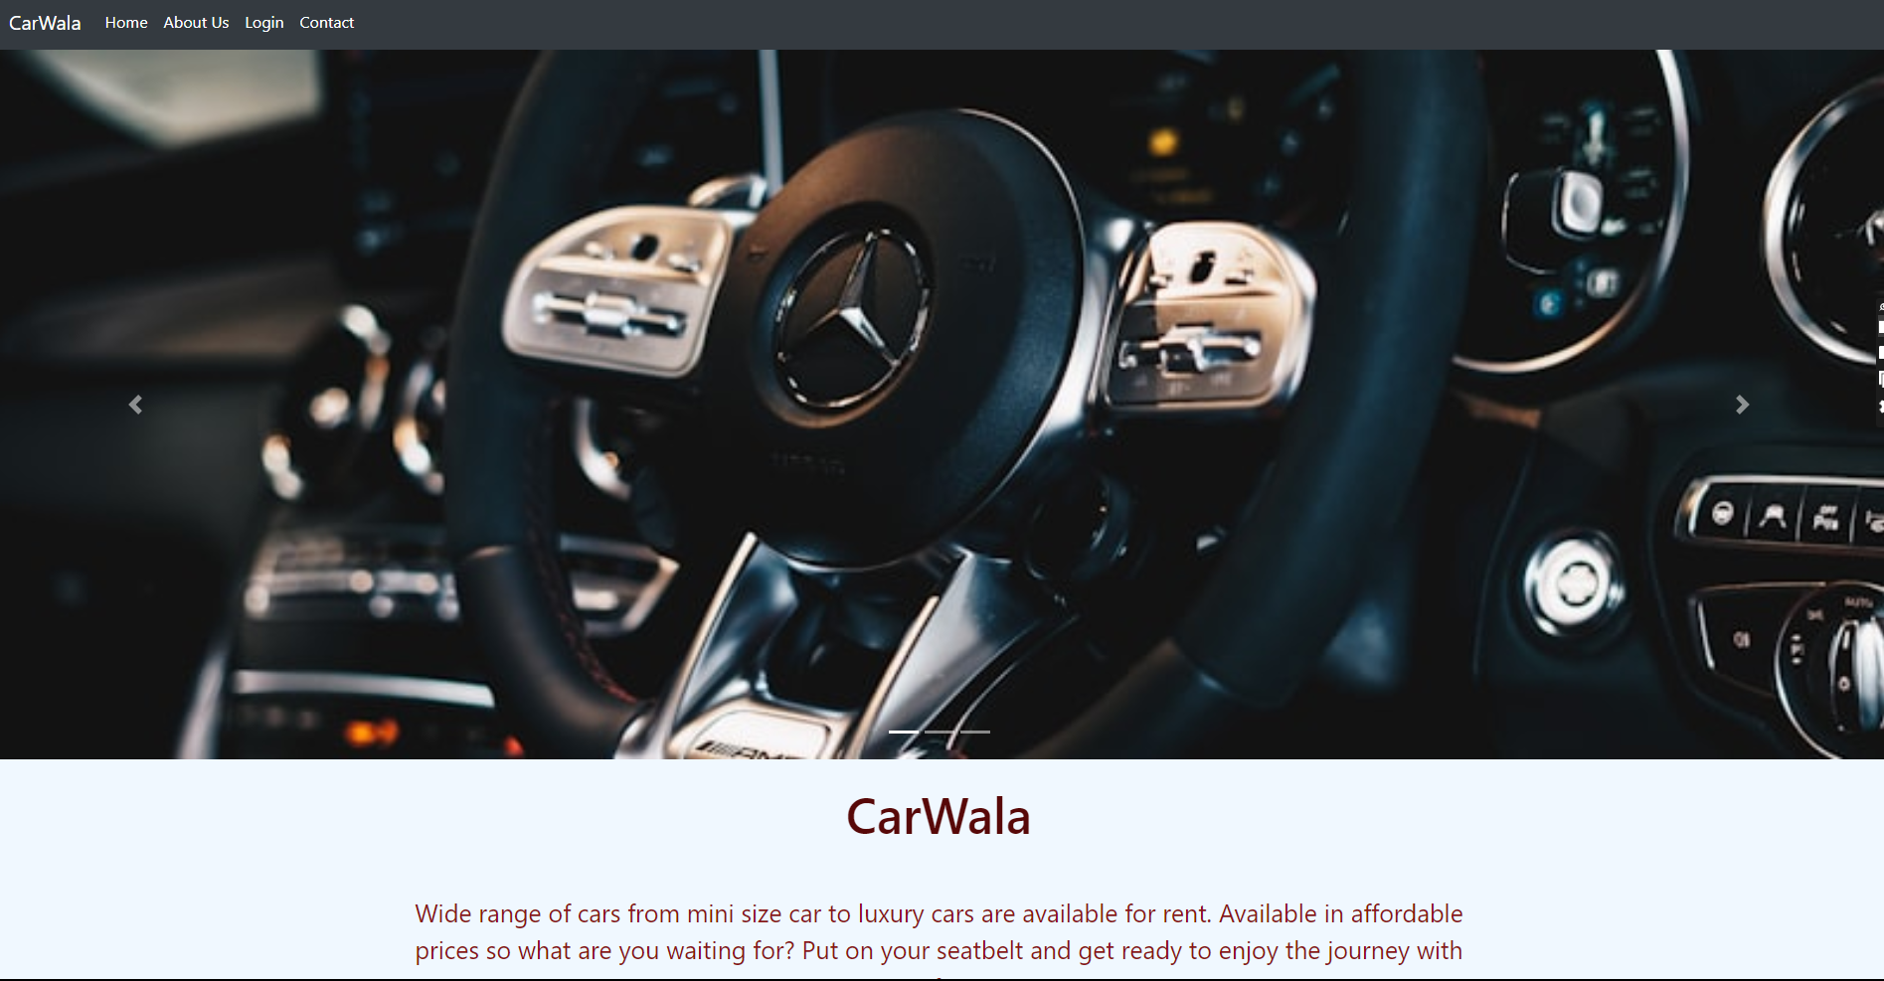
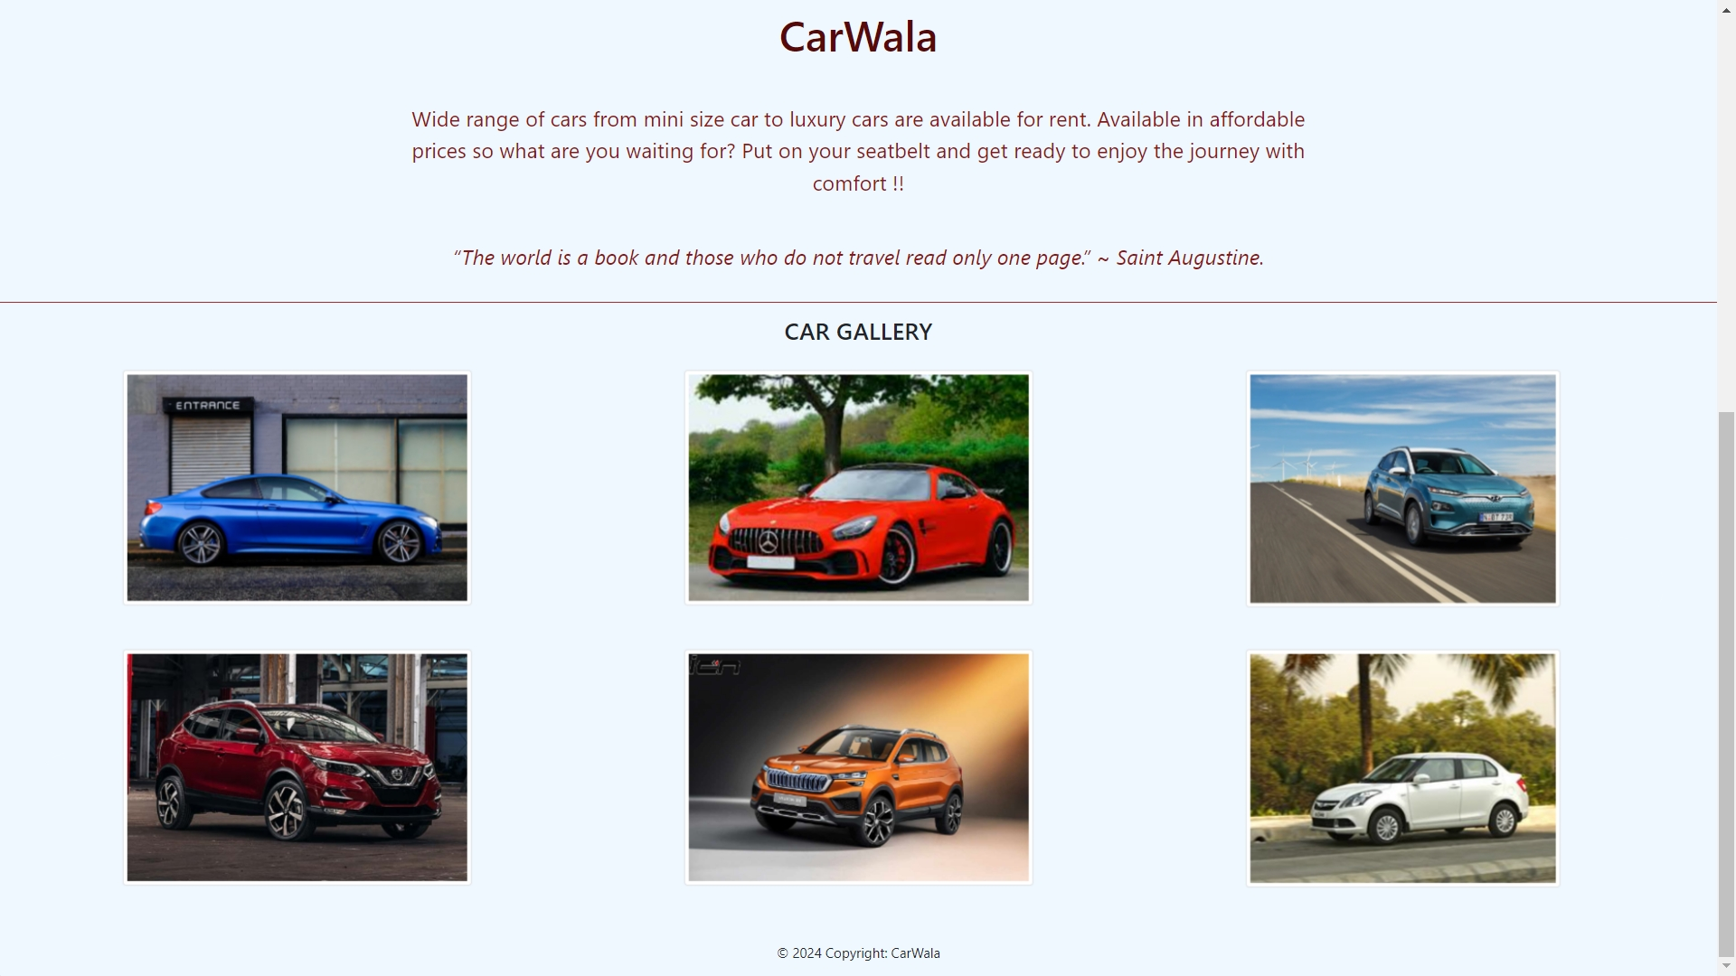
Modelling & Result

Slide 9
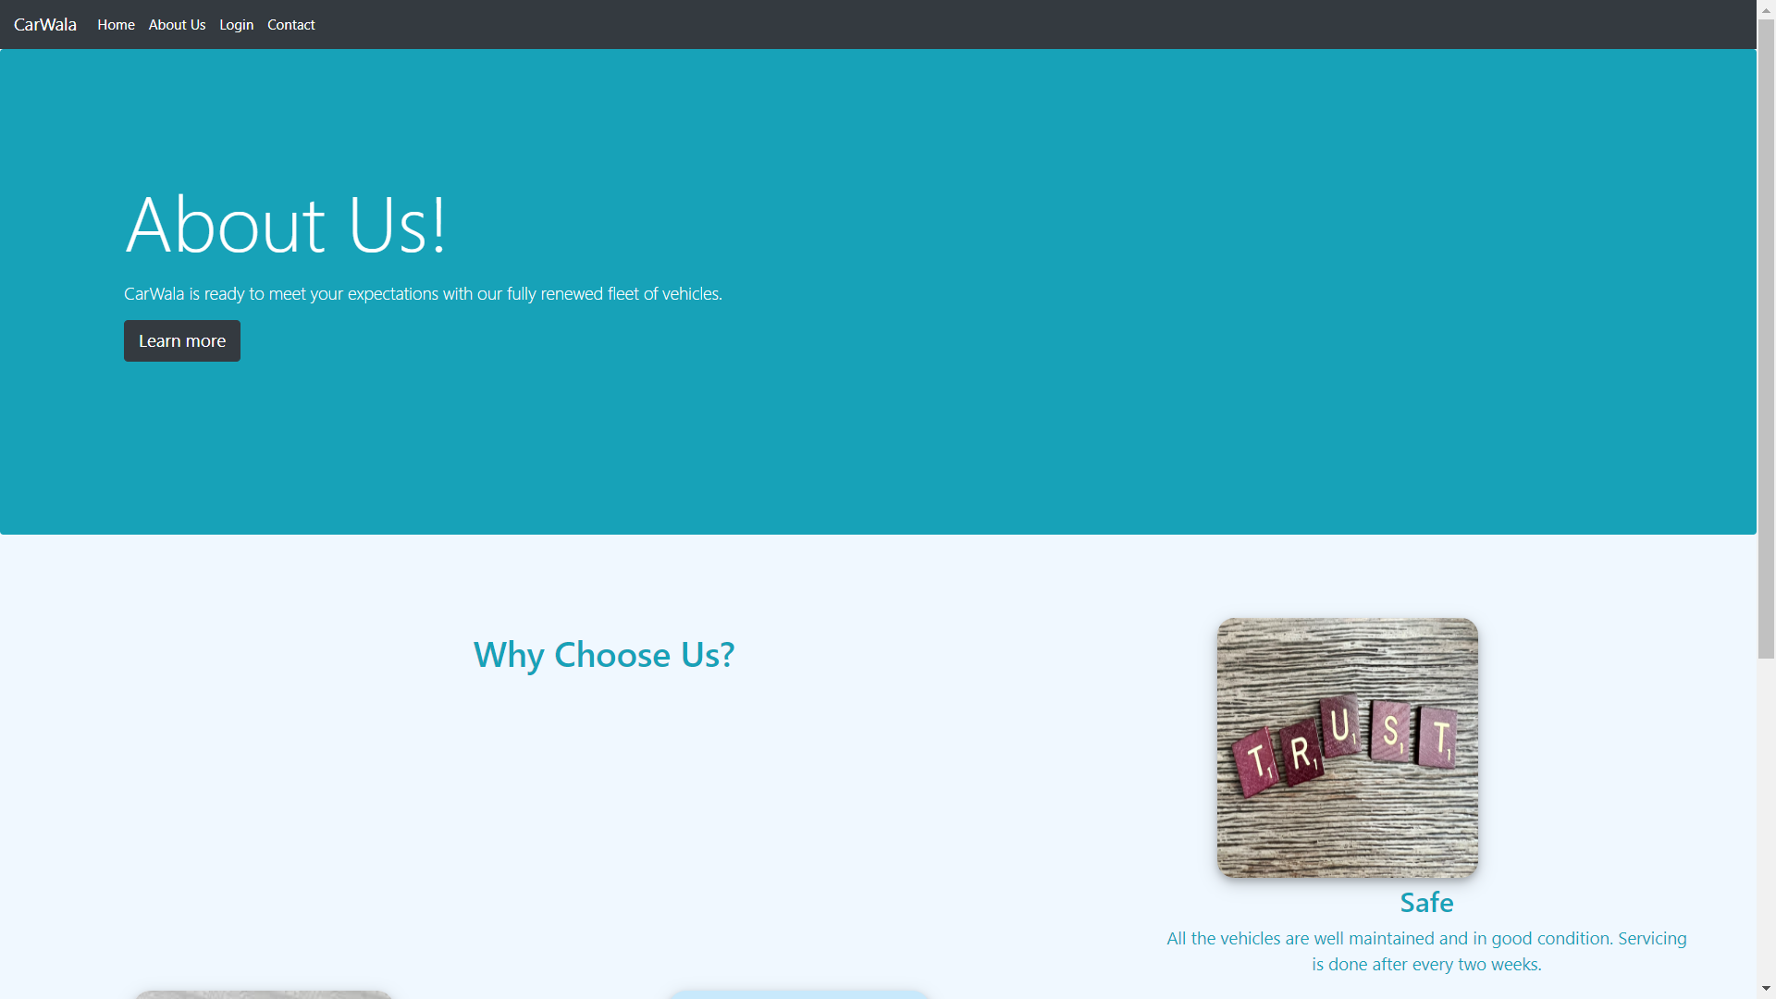
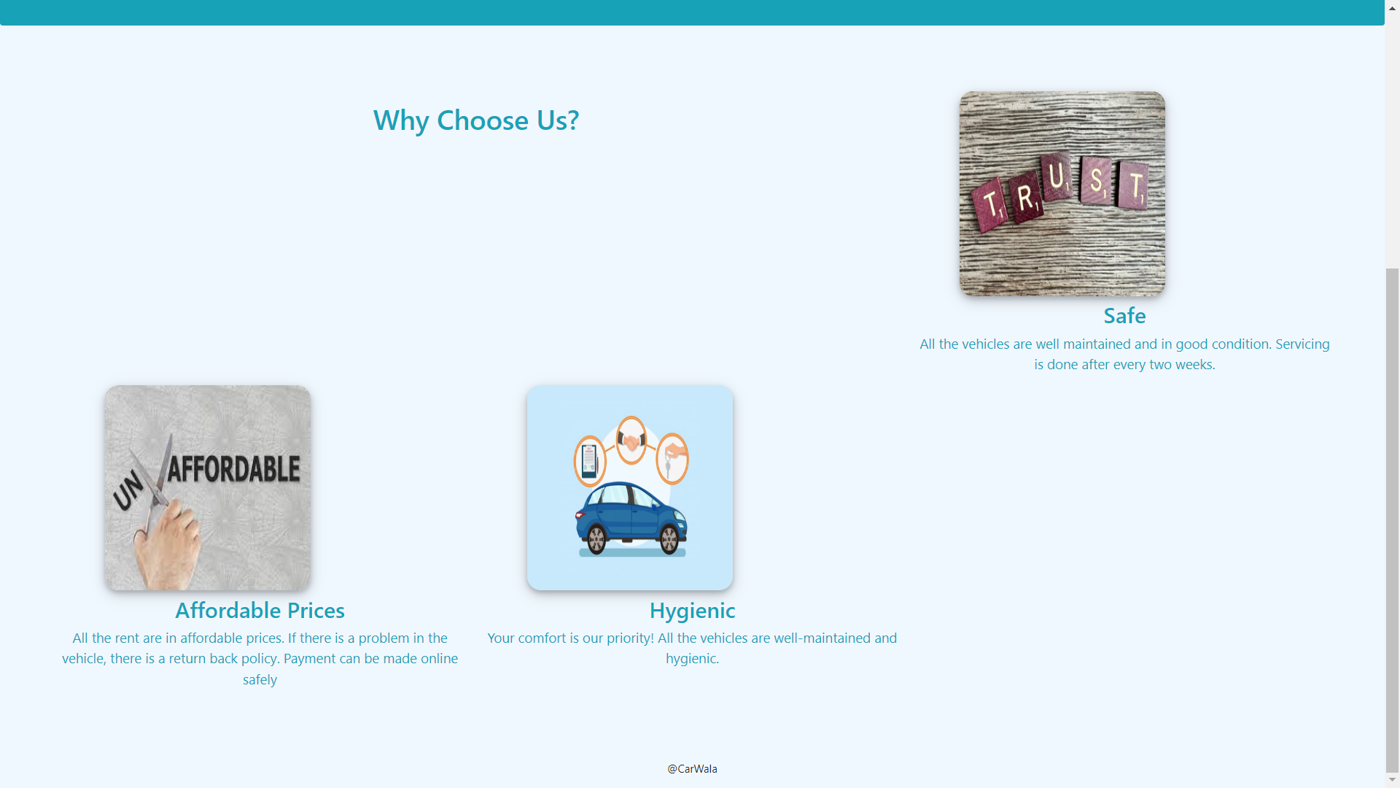
Modelling & Result

Slide 10
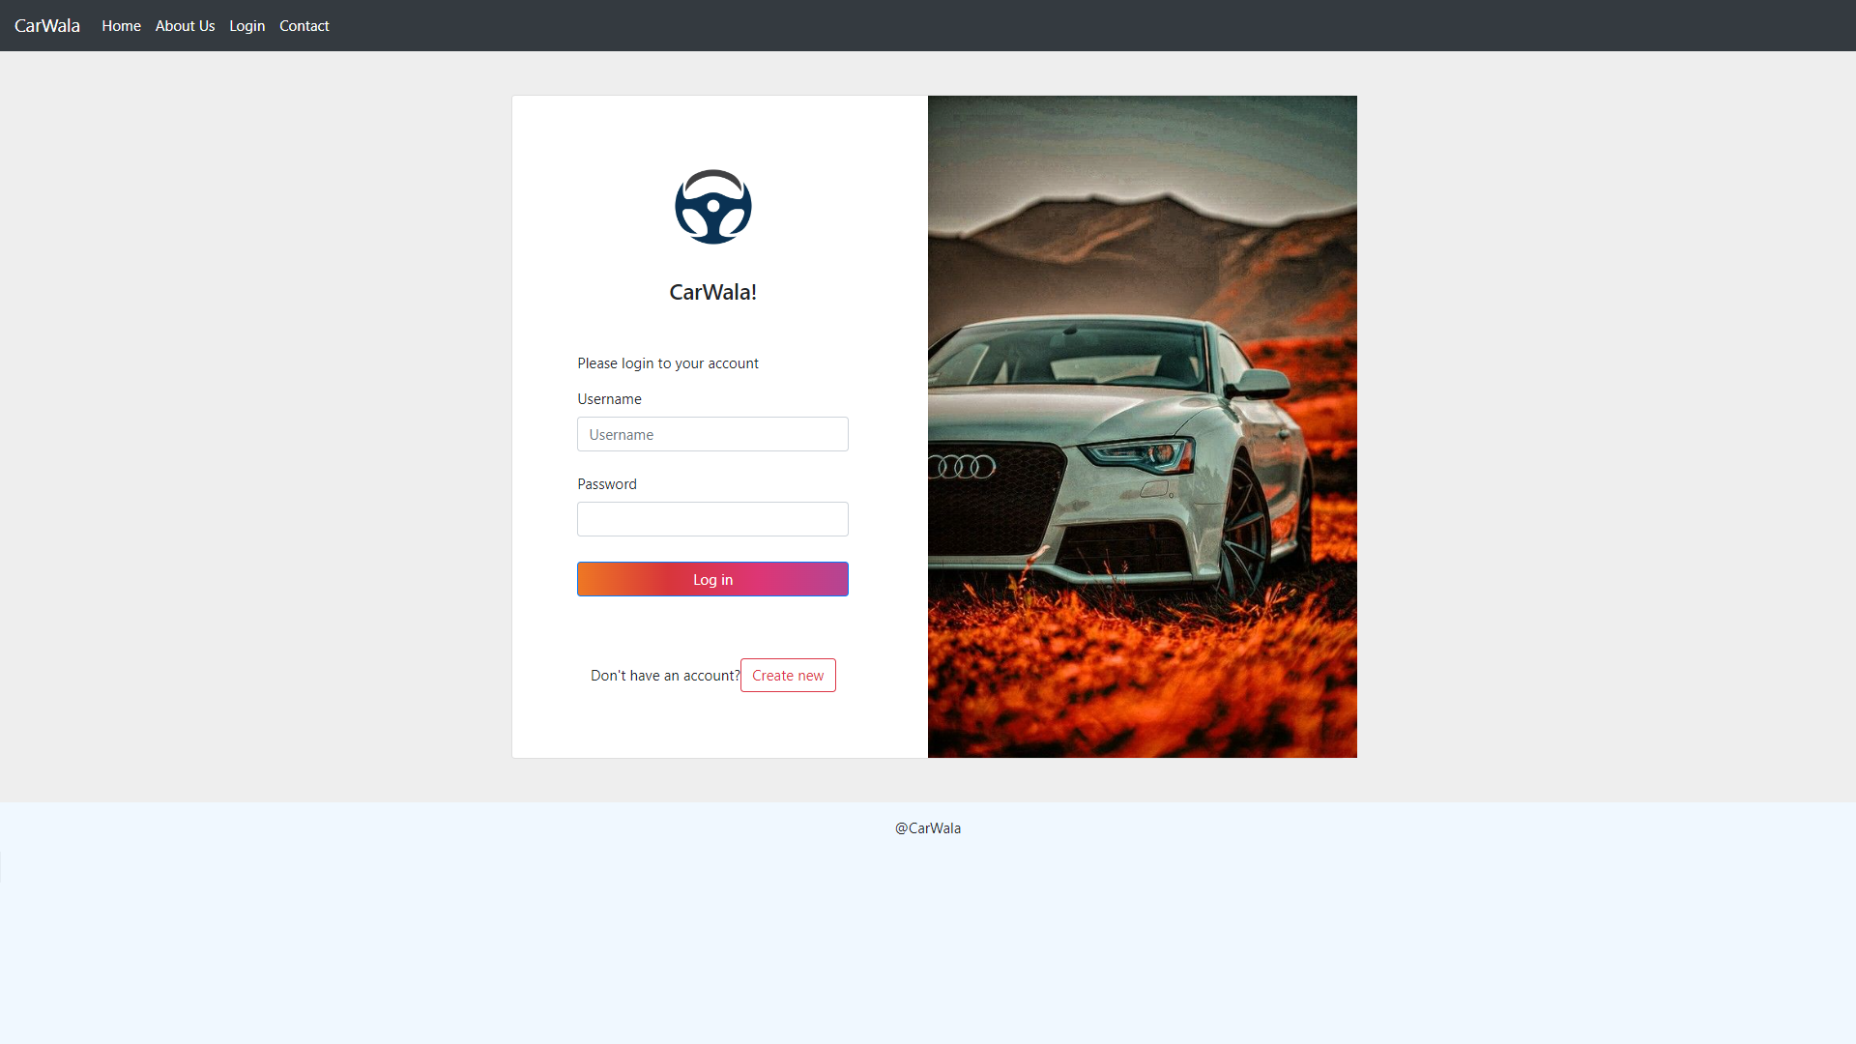
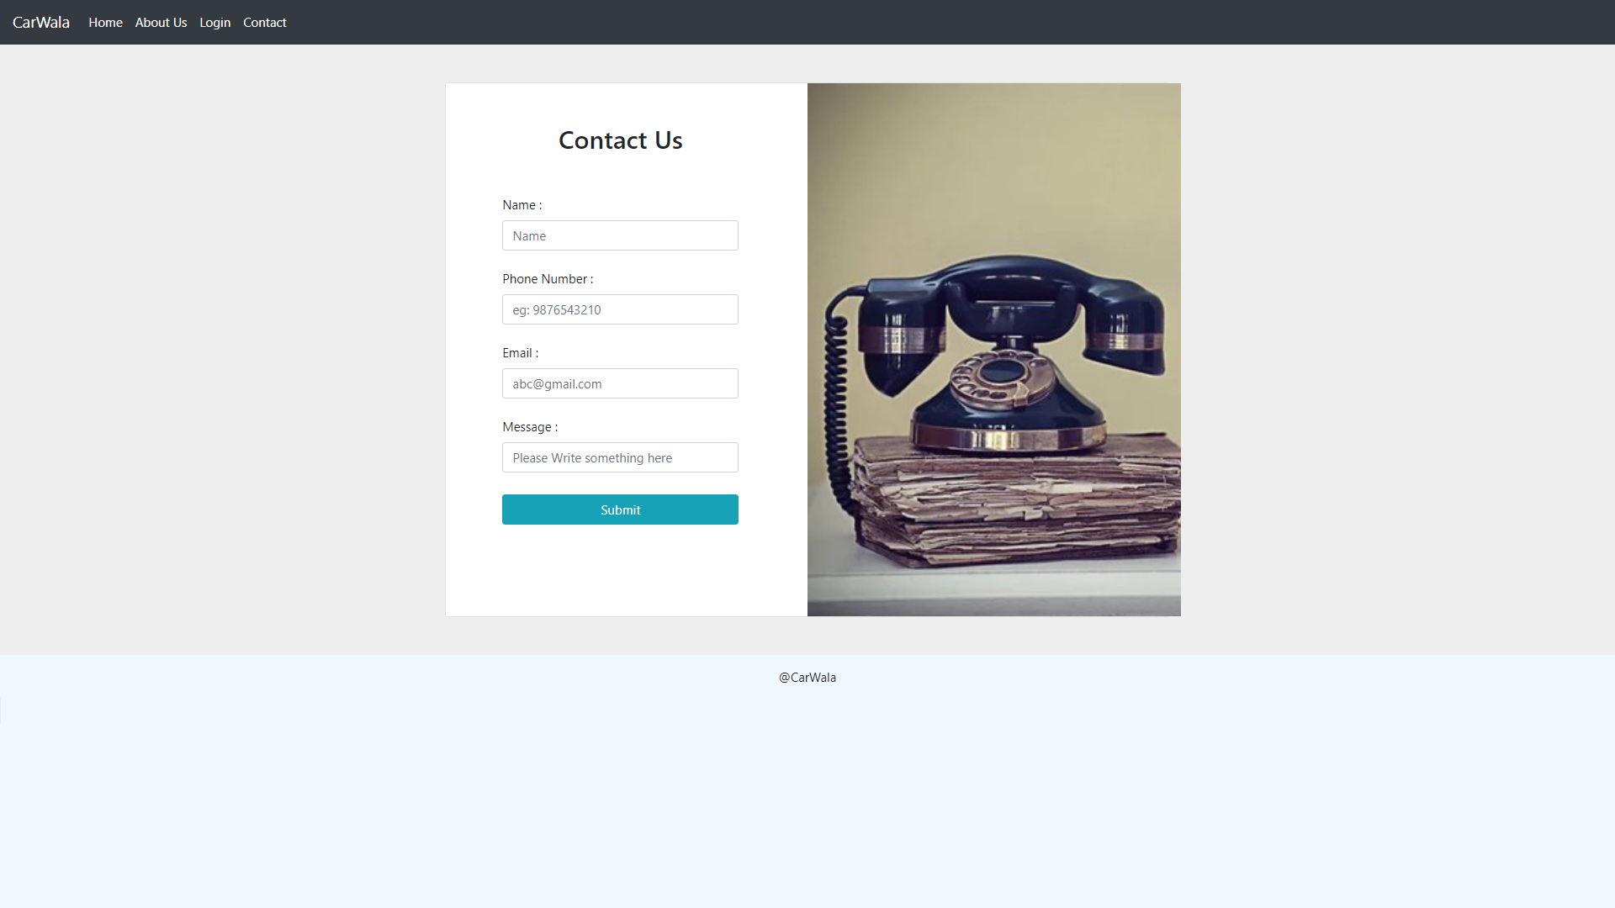
Modelling & Result

Slide 11

Conclusion
Revolutionize Car Rentals
The car rental application will transform the way customers plan and book their transportation needs, providing a superior, technology-driven experience.
Competitive Advantage
Our innovative features and user-centric approach will give us a unique edge in the market and drive customer loyalty.
Scalable Growth
The robust technology stack and cloud-based infrastructure will enable us to rapidly scale the application and expand our reach.
Our application will stand out with its personalized recommendations, seamless booking, and value-added services.

Slide 12


Notes:
Thank You !!

